Slide 1
Q1 Zombie Computer
Bringing Q1 Lite back from the dead
Morten Jagd Christensen / 06. 09. 2024

Slide 2
Contents
01. About Q1
The world's first personal computer
02. Emulation + Demo
How to start emulating an unknown system
03. Q1 Emulator architecture + Demo
The proof of the pudding

Slide 3

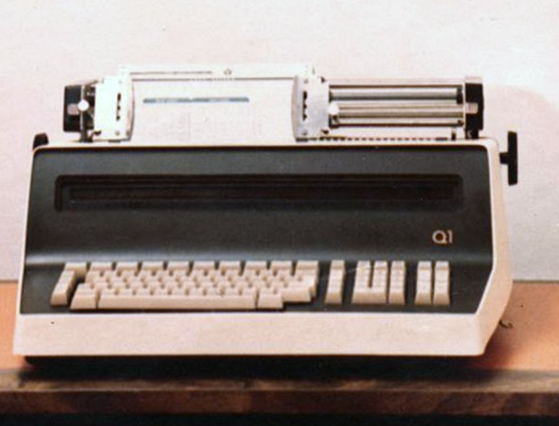
Q1 - 1972
Generation 1 of Q1 First unit sold in 1972
CPU: 8008

Slide 4
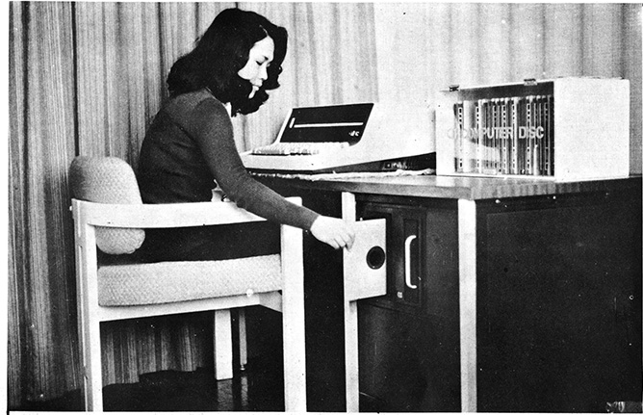
Not a home computer
Q1 supported floppy disks and hard disks, serial communications and a one line
display

Slide 5
Used primary for business purposes: accounting, reports, inventory and ressource scheduling. Programs could be written in assembler or in PL/1.
Pl/1 programs were compiled into a Q1 pseudo machine code at a higher level than assembler (stack machine)

Slide 6
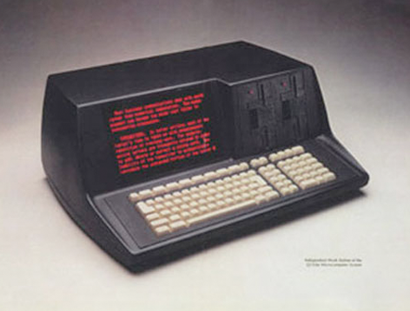
Q1 generation 3
Q1 Lite – circa 1977-1978
With a multiline display and integrated, but prestandard, floppy drives. The printer was now external!
CPU: z80 (gen. 2 used 8080)

Slide 7
Resources
Three Q1 Lites are known to exist (possibly four)
Datamuseum.dk
technikum29.de
One privately owned (peel.dk)
Maybe one at http://www.datormuseum.se
A few manuals exist with some technical information
IO address guide
OS (ROS) information (memory locations and system calls)
Q1 PL/1 info
ROM images have been copied
A few (~5) floppy disk images have been copied
One person (still) alive who was Q1 software developer

Slide 8
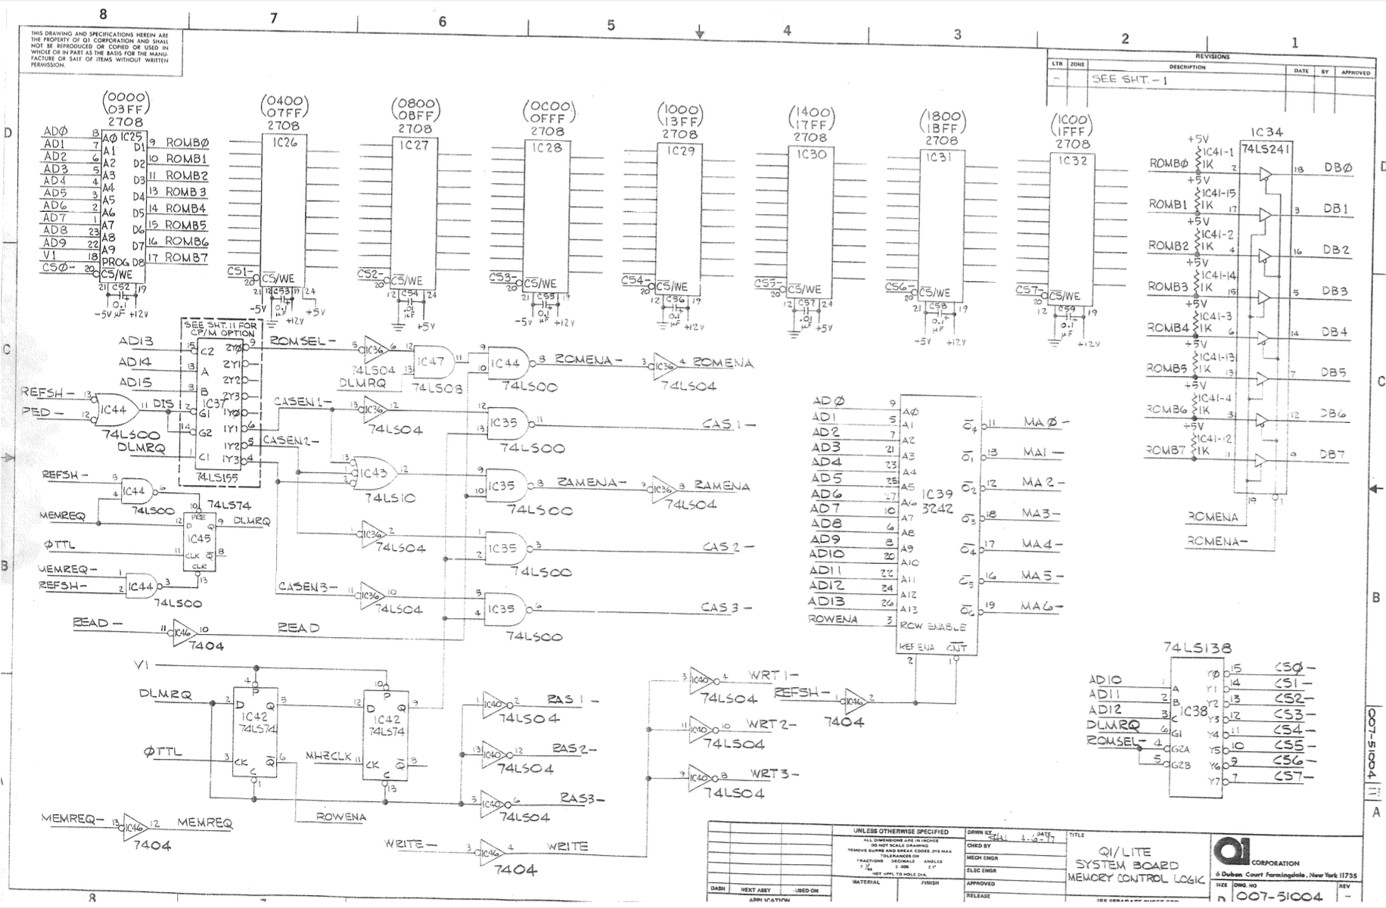
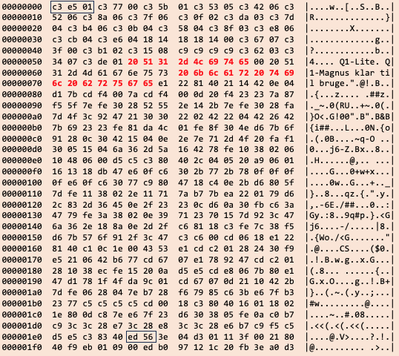
Resources

Slide 9
DEMO 1
Emulator evolution

Slide 10
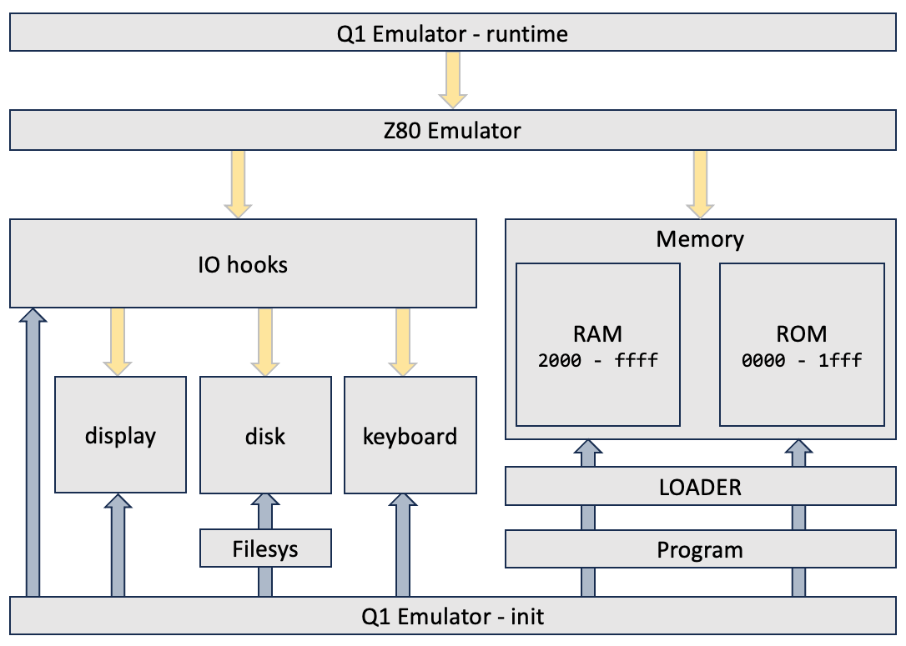
Emulator architecture

Slide 11
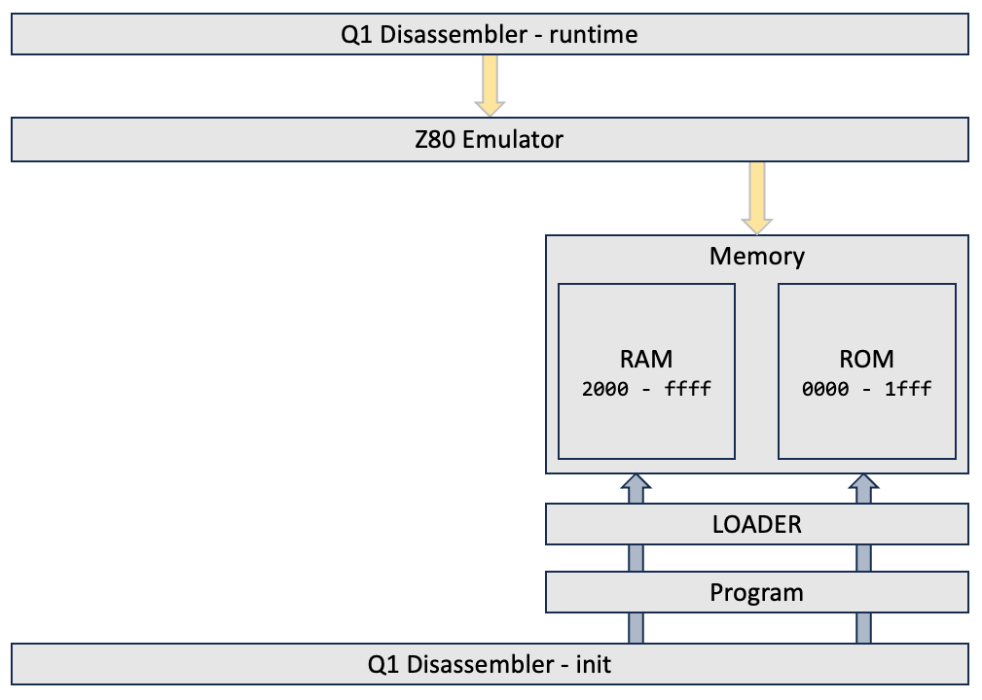
Disassembler architecture

Slide 12
DEMO 2
Current State

Slide 13
Thanks !
https://datamuseum.dk/wiki/Q1_Microlite
https://q1-lite-emulator.readthedocs.io/en/latest/index.html
https://github.com/Datamuseum-DK/Q1-Emulator
https://q1-lite-emulator.readthedocs.io/en/latest/

